Slide 1
Hot Cities in Tulsa County for Establishing Pizza Restaurant
Matthew Bamidele
IBM Data Science Capstone Project
May 27, 2020

Slide 2
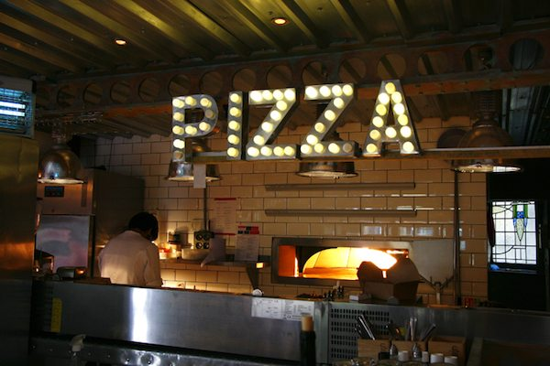
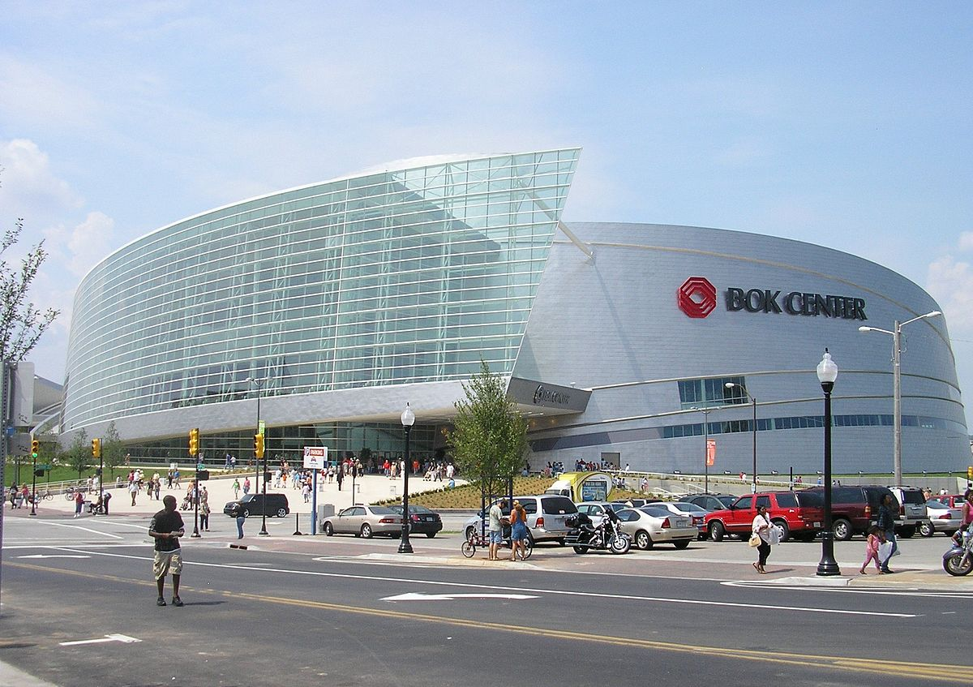

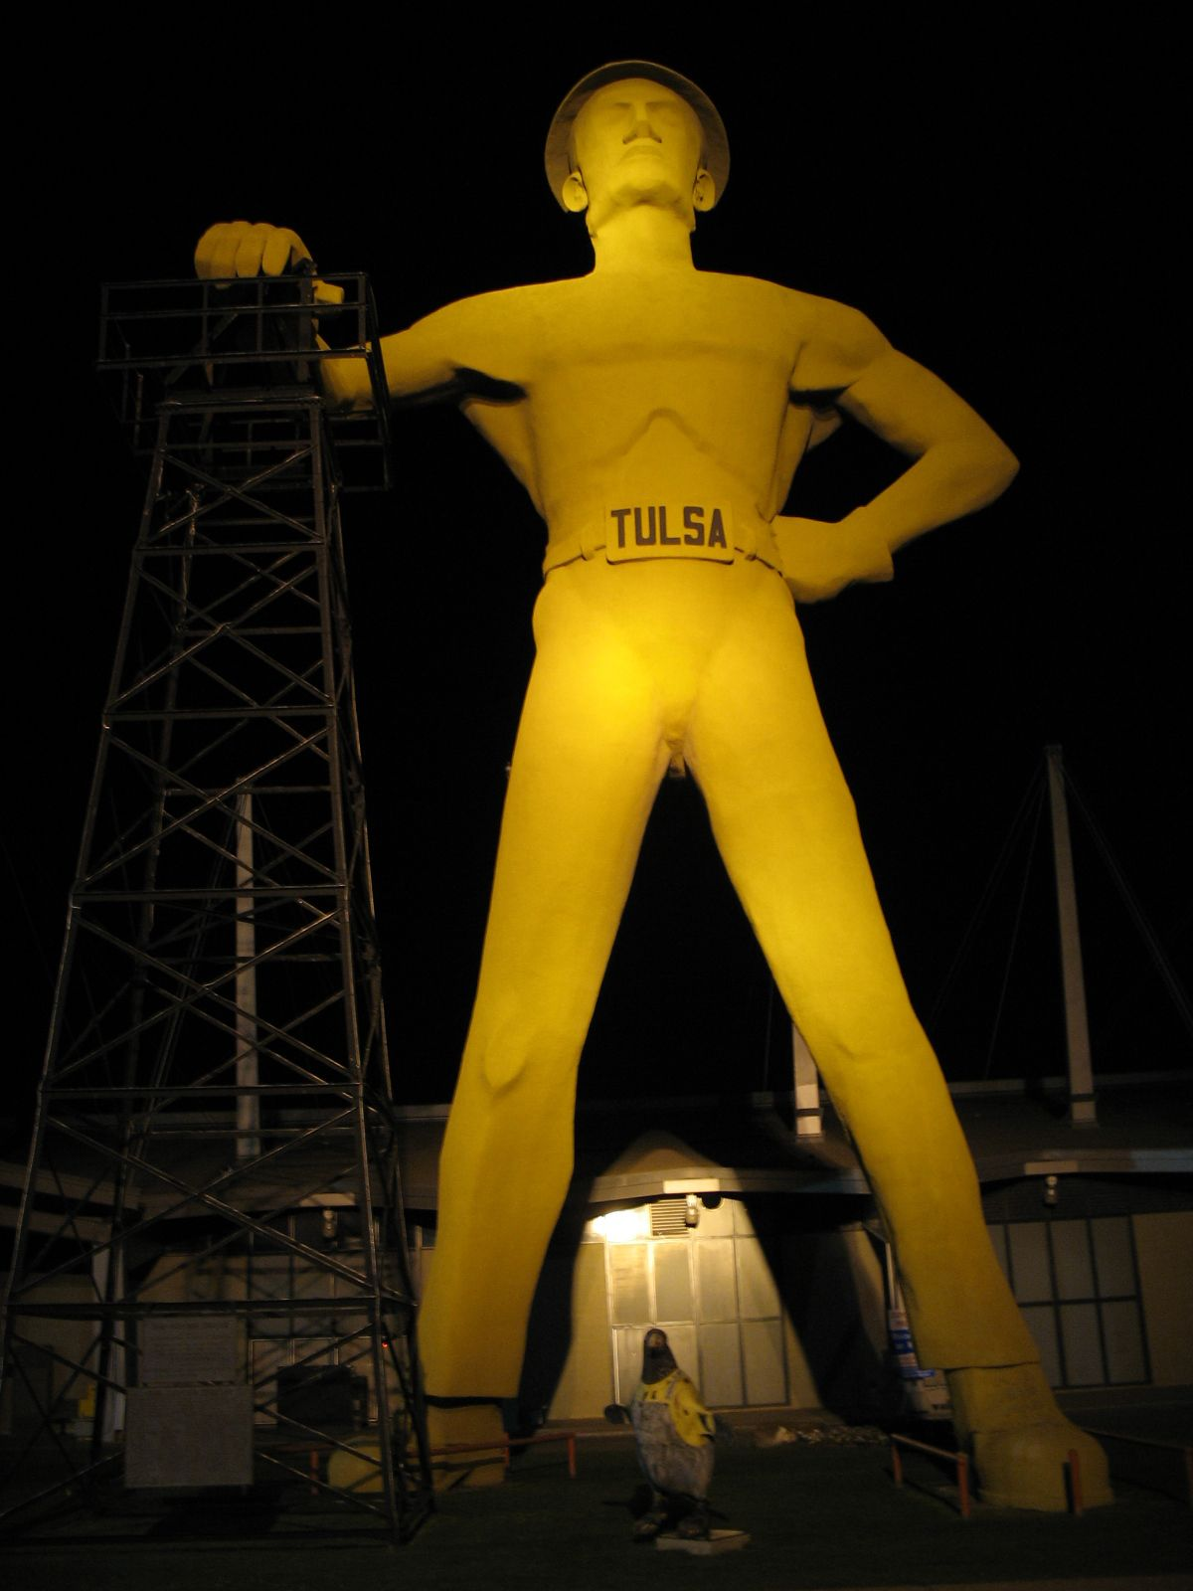
Introduction

Slide 3
Problem
Resident
Best place/city in Tulsa county with access to choice of pizza restaurant
Entrepreneur
Top places/cities in Tulsa county to consider for investment/establishing pizza restaurant

Slide 4


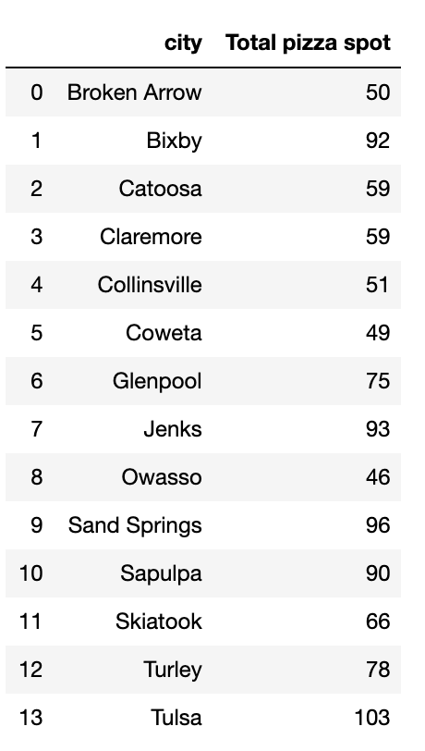

Pizza restaurants in Tulsa county
It is clear that Tulsa, Sand Springs, Jenks and Bixby have the greatest number of pizza spots in Tulsa county
z

Slide 5
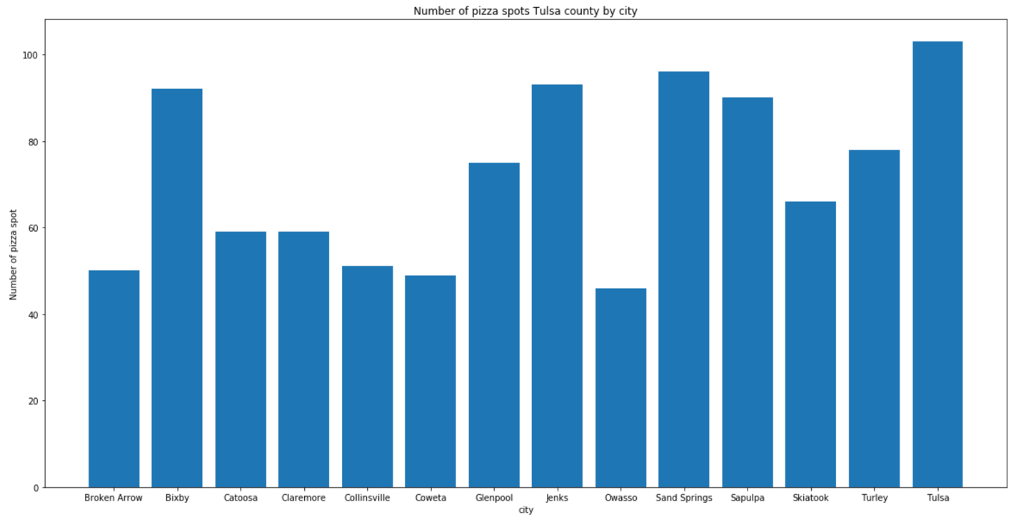

Slide 6
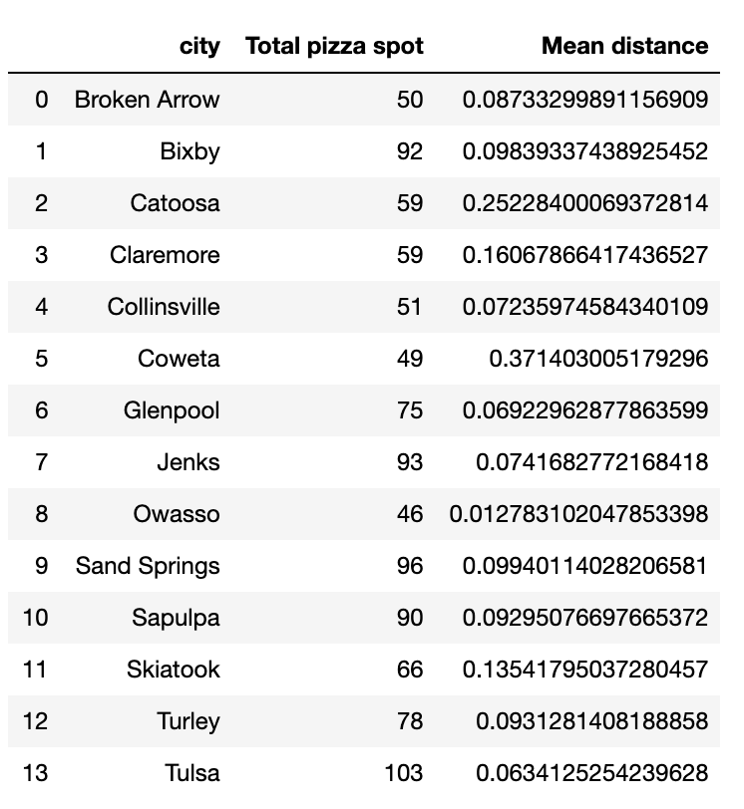
Ease of access to pizza spot
The cities with the very low mean distance are Owasso, Tulsa, Glenpool, Jenks. It is very much easy for residents in these cities to get a nearest pizza spot. Should an entrepreneur establish more pizza spots in these cities or in cities with high mean distance to pizza spot? Comparison of population of thes cities will be in making right decision for an entrepreneur.
z

Slide 7
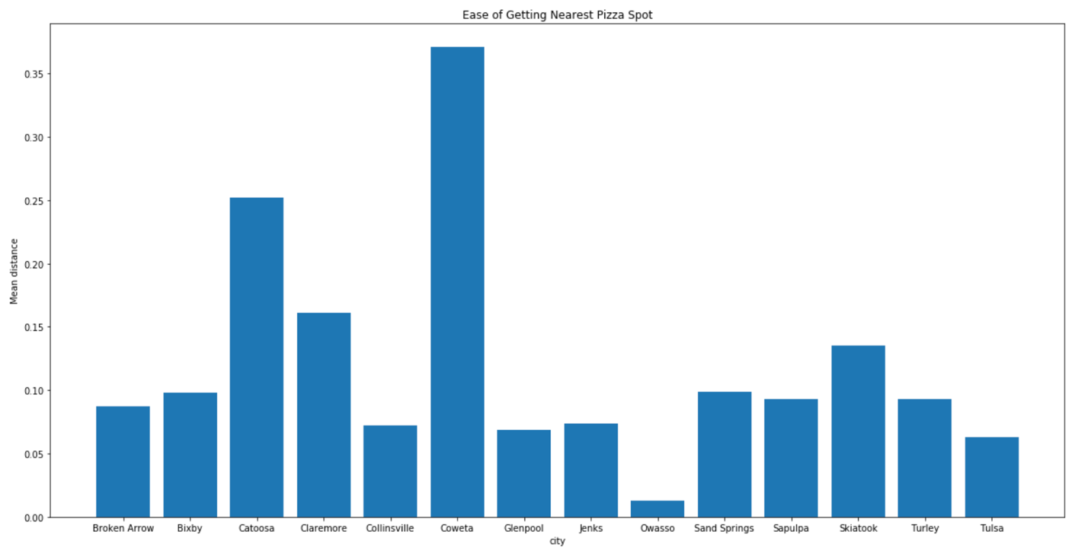

Slide 8
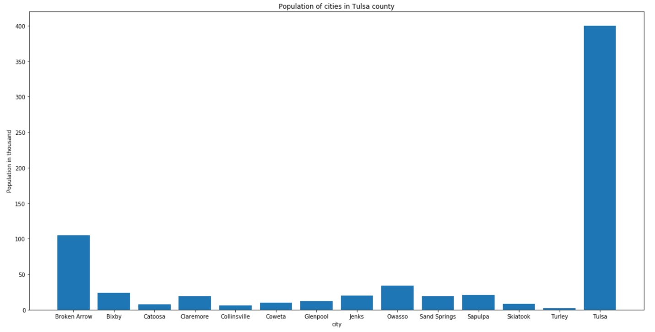
Population Data

Slide 9
Conclusion
Cities of Tulsa, Broken Arrow, Owasso and Bixby have high population. These cities, especially Tulsa should be considered by an entrepreneur who want to establish a pizza restaurants in Tulsa county.

